Slide 1
Predicting Prison Recidivism with Supervised Learning Models
Max Barry
February 13, 2019

Slide 2
Incarcerated
Population of US
Population Metro Chicago
2.720 million
2.298 million
650,000 per year
2 out of 3 will be convicted again

Slide 3
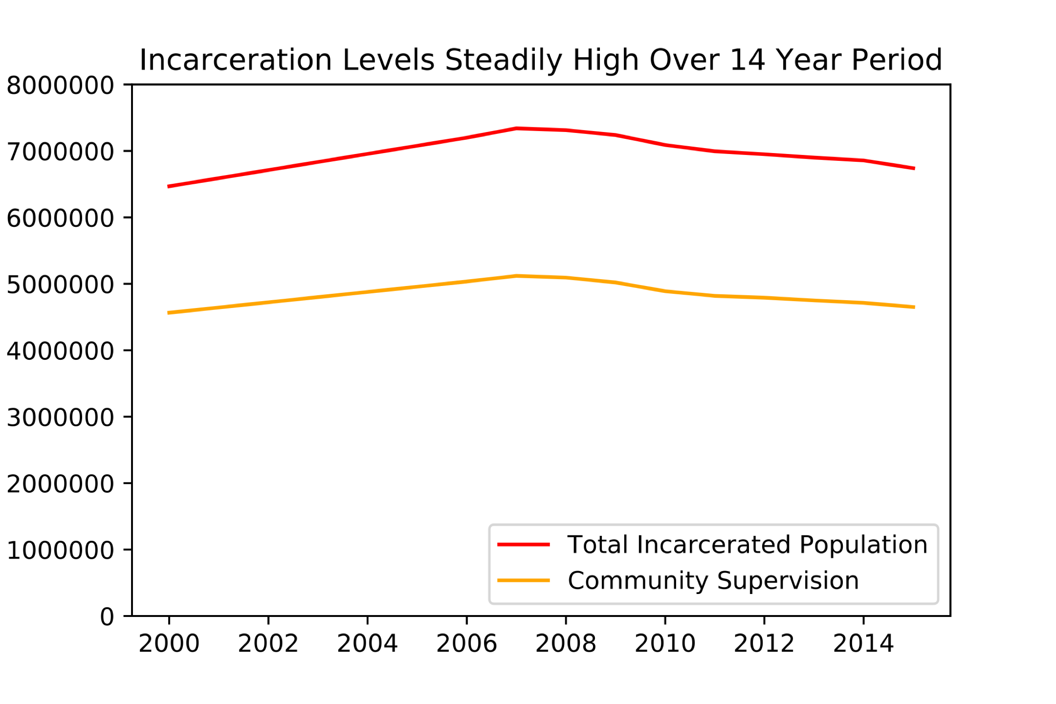
Notes:
626,024 Prisoners released in 2016, https://www.bjs.gov/index.cfm?ty=nps
28, 615 released in Illinois in 2016, https://www.bjs.gov/index.cfm?ty=nps
29,428 on parole in Illinois in 2016
874,777 parole in 2016
Maybe get a graph that has probation taken out.

Slide 4
Better Allocation of Resources

Slide 5
Final Data Set
Dropped rows with null:
26,020 records reduced to 24,150
Best performing dataframe did not include year released or target population flag.

Slide 6
Data - Source
3-Year Recidivism for Offenders Released from Prison in Iowa
Notes:
24150 Individual Records

Slide 7
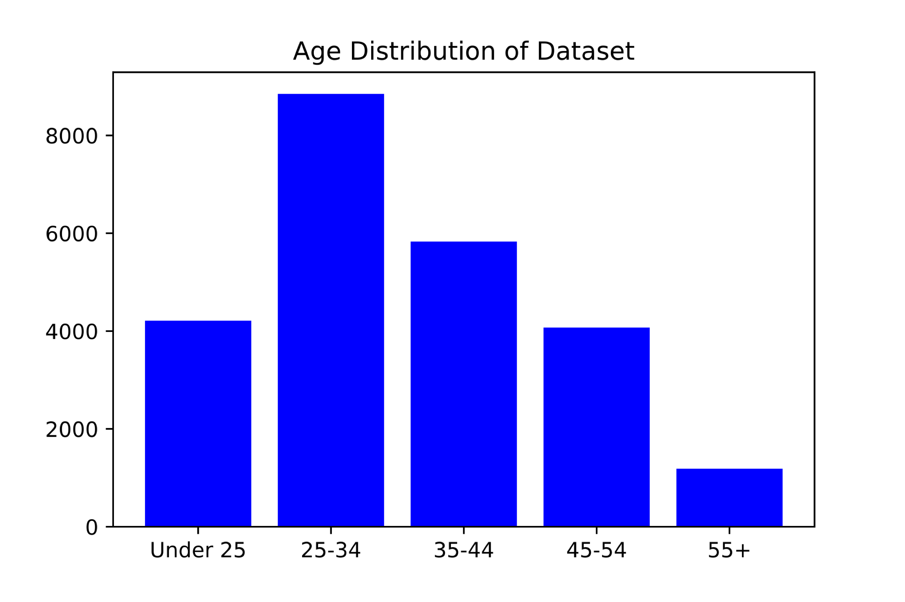

Slide 8
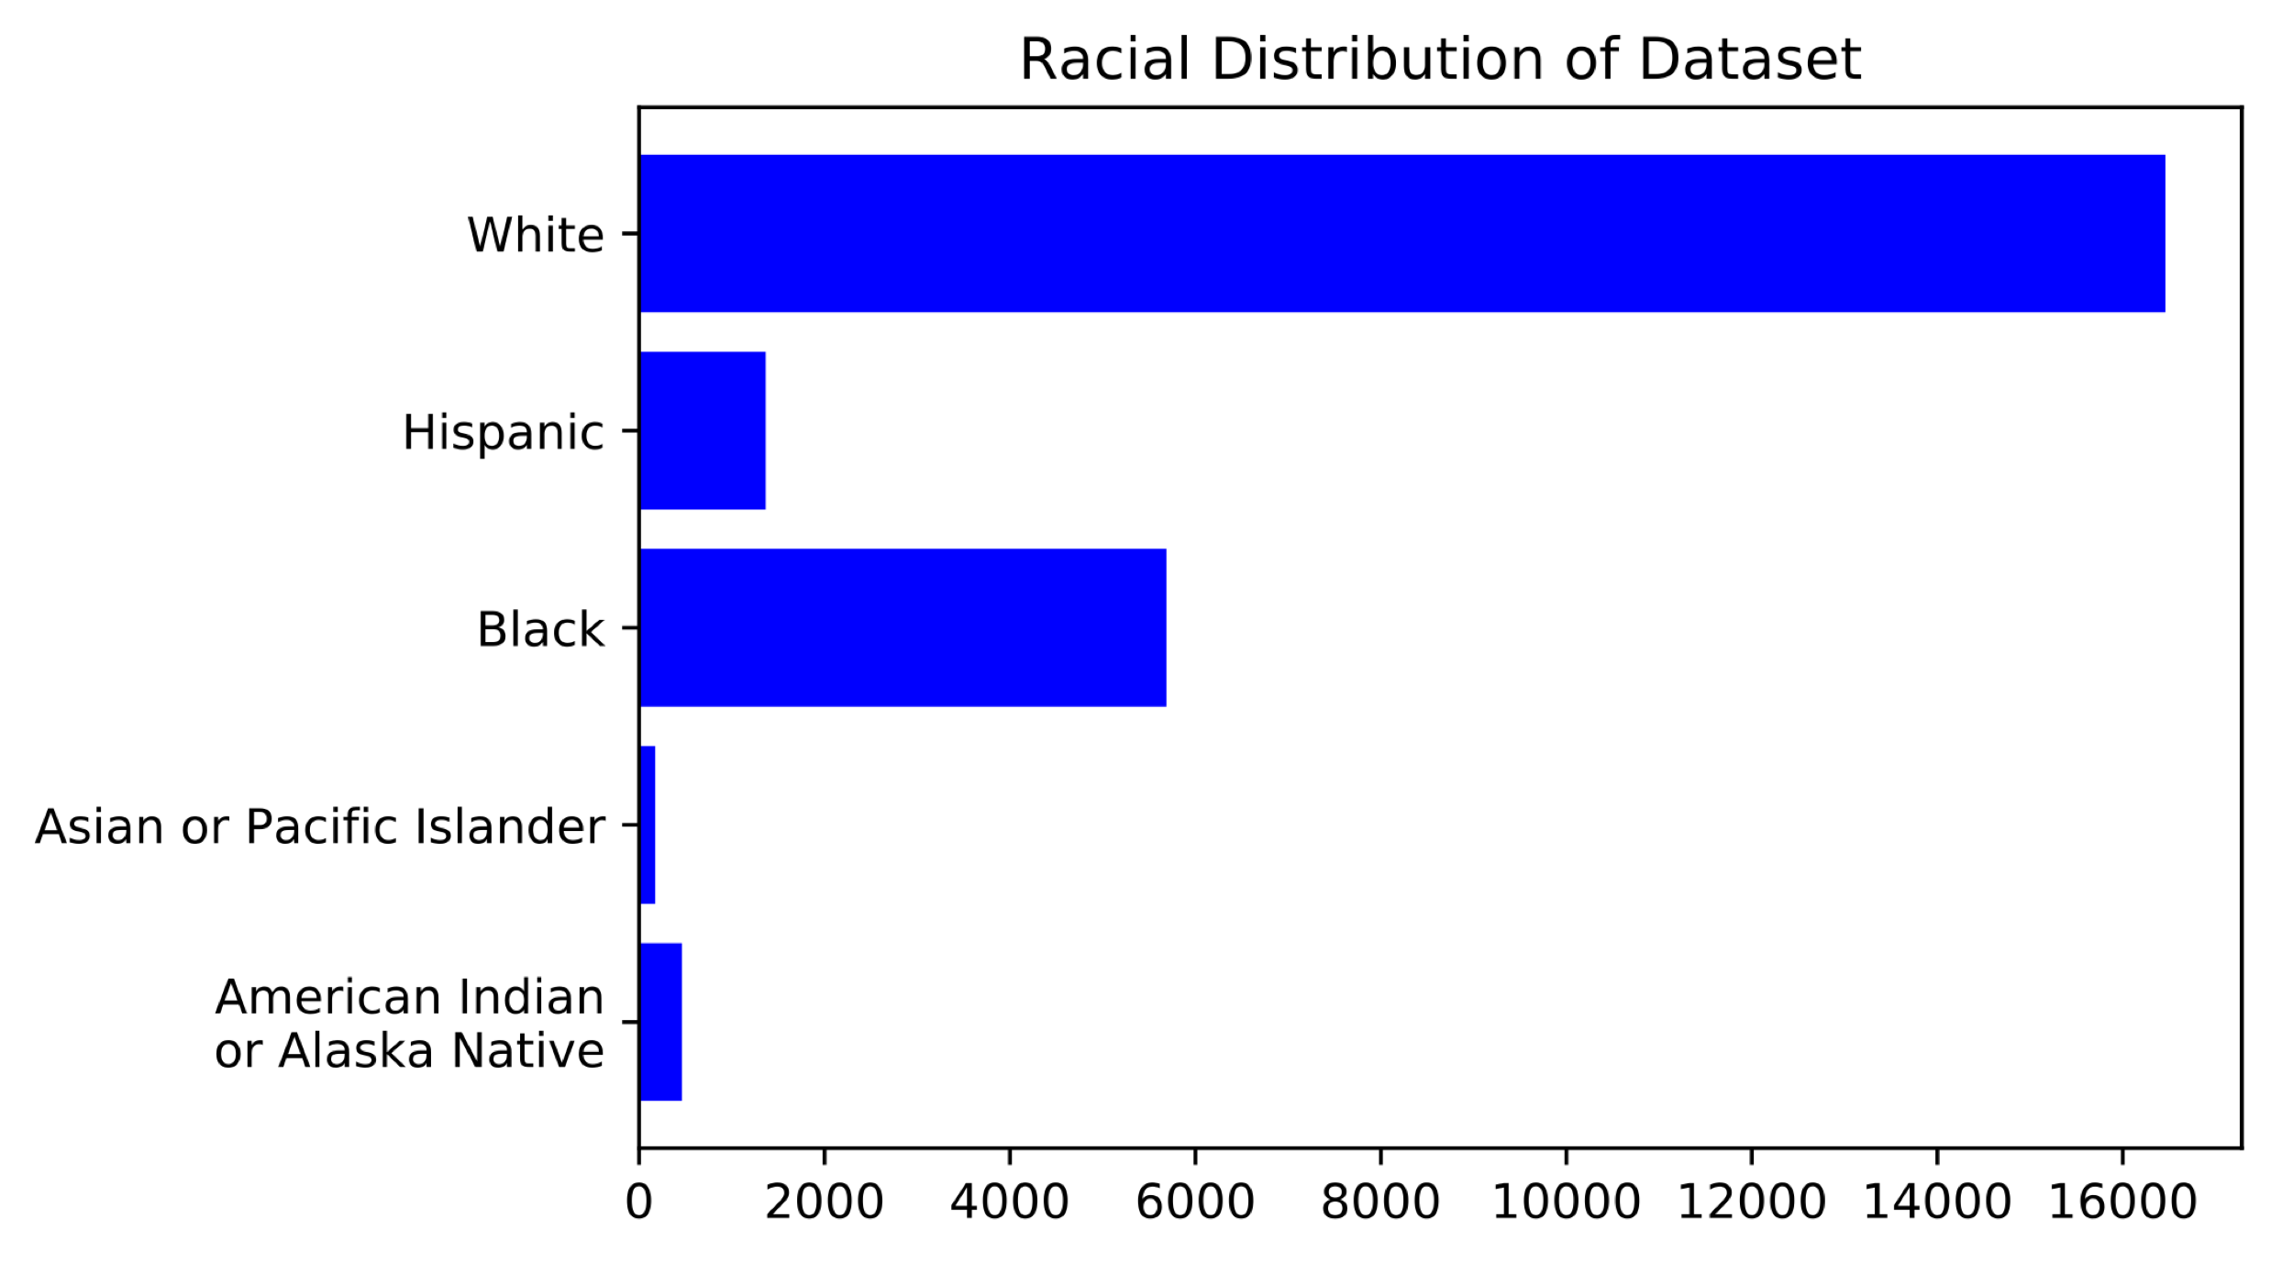

Slide 9
Offense Subtypes
Alcohol | Forgery/Fraud | Stolen Property
Animals | Kidnap | Theft
Arson | Murder/Manslaughter | Traffic
Assault | Prostitution/Pimping | Trafficking
Burglary | Robbery | Vandalism
Drug Possession | Sex | Weapons
Flight/Escape | Sex Offender Registry
Notes:
Target Populatio

Slide 10
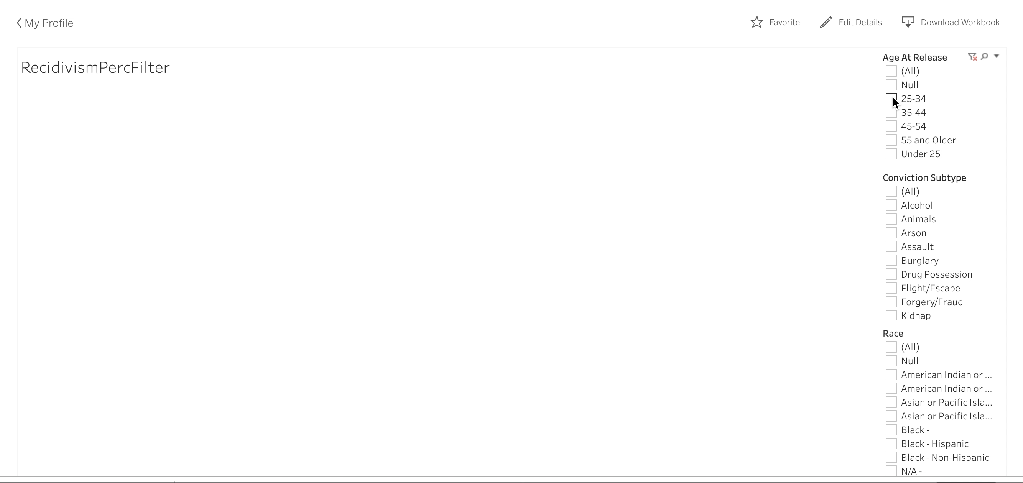
Tableau Figure

Slide 11
Logistic Classifier
Best C = 1.21
Test data roc_auc score = .669

Slide 12
Hispanic | 0.03363891
Black | 0.009661003
White | 0.009431723
Asian or Pacific Islander | 0.005528114
American Indian or Alaska Native | 0.004892633
55 and older | 0.032662441
25-34 | 0.014206552
45-54 | 0.011522389
under 25 | 0.011461515
35-44 | 0.011308532

Slide 13
Murder/Manslaughter | 0.016158087
Assault | 0.013118904
Sex | 0.011277774
OWI | 0.00932378
Burglary | 0.008065652

Slide 14
Conclusions

Slide 15
Conclusions

Slide 16
Future Work
Add different states

Slide 17
Appendix

Slide 18
Motivation
Ranking | Title | Prison Population Total
1 | United States of America | 2 121 600
2 | China | 1 649 804
3 | Brazil | 700 432
4 | Russian Federation | 563 166
5 | India | 419 623
6 | Thailand | 375 763
7 | Turkey | 260 000
8 | Indonesia | 256 051
9 | Iran | 230 000
10 | Mexico | 204 422
Source: World Prison Brief,
Accessed, Feb. 10, 2019
Notes:
U.S. has a prison prison population rate of 655 prisoners per 100000, http://www.prisonstudies.org/sites/default/files/resources/downloads/wppl_12.pdf
World prison population rate is 145 per 100,000, http://www.prisonstudies.org/sites/default/files/resources/downloads/wppl_12.pdf

